Slide 1
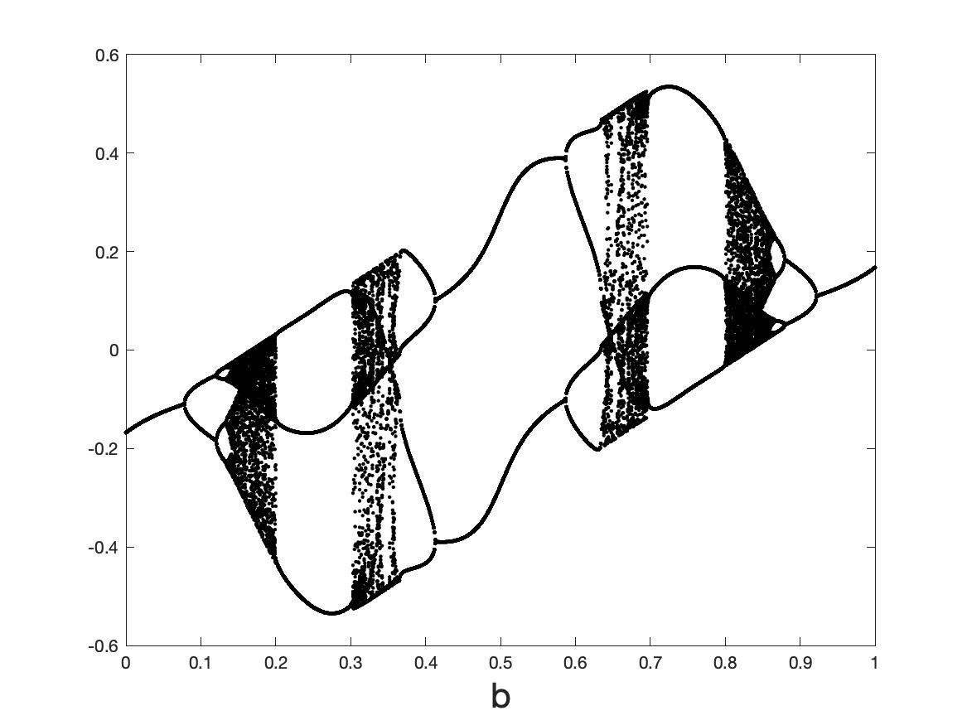


Lecture 7. Neural ODES for and as dynamical systems
Chris Budd OBE (Bath)

Slide 2
Some papers/books to look at
Chen et. al., Neural Ordinary Differential Equations
Matlab and Simulink, Dynamical System Modelling Using Neural ODE
di Bernardo et. al., Piecewise smooth dynamical systems
Brunton, Kutz et. al, Discovering governing equations from data by sparse identification of nonlinear dynamical systems
Ashwin et. al. RNNS

Slide 3
DEFINE A DS HERE

Slide 4
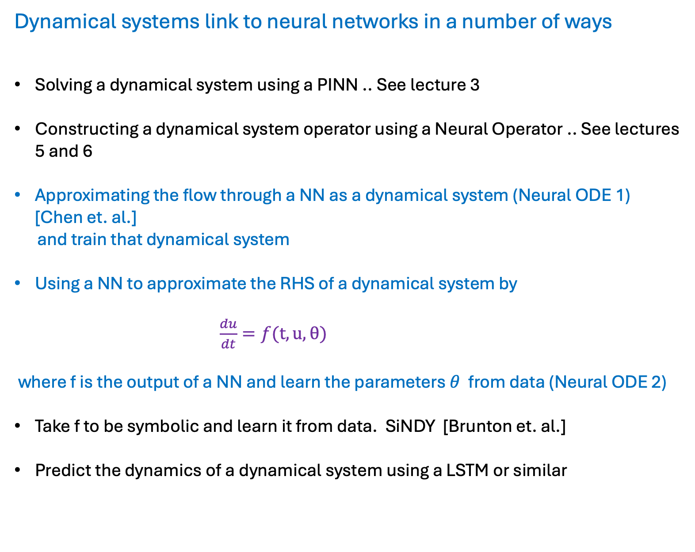
Dynamical systems link to neural networks in a number of ways
Solving a dynamical system using a PINN .. See lecture 3
Constructing a dynamical system operator using a Neural Operator .. See lectures 5 and 6
Approximating the flow through a NN as a dynamical system (Neural ODE 1) [Chen et. al.]
and train that dynamical system
Using a NN to approximate the RHS of a dynamical system by
$\frac{du}{dt}=f(t,u,θ)$
where f is the output of a NN and learn the parameters $θ$ from data (Neural ODE 2)
Take f to be symbolic and learn it from data. SiNDY [Brunton et. al.]
Predict the dynamics of a dynamical system using a LSTM or similar

Slide 5
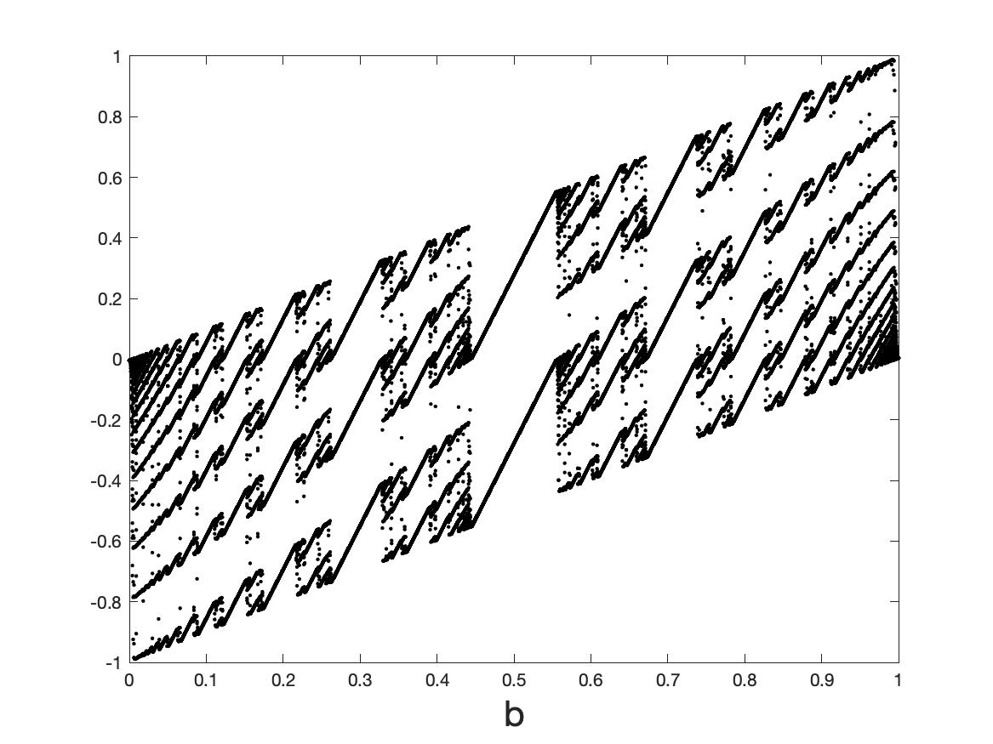
AIM:
Understand, and control, the dynamical behaviour and training of (feed forward) Neural Nets and Neural ODEs by using results from the theory of
dynamical systems (smooth and non-smooth)

Slide 6
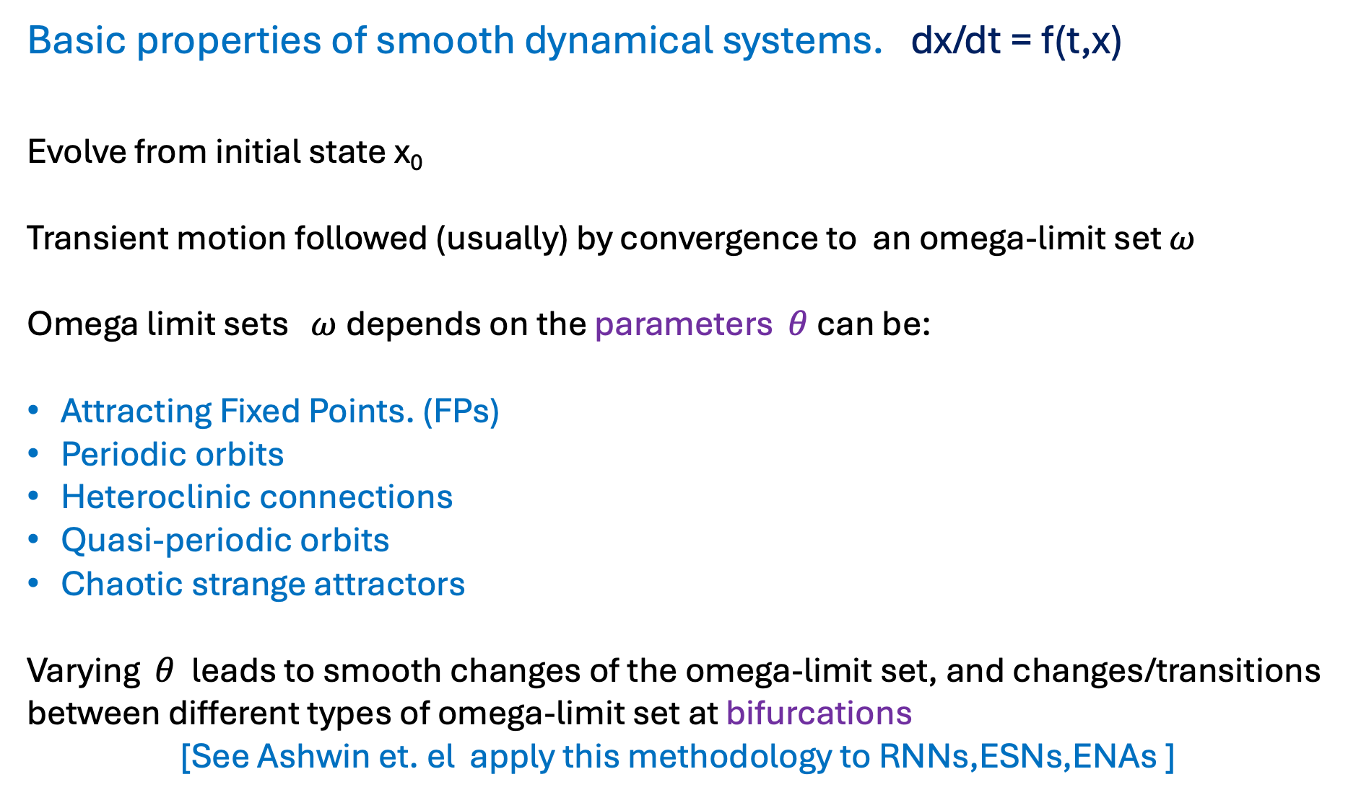
Basic properties of smooth dynamical systems. dx/dt = f(t,x)
Evolve from initial state x₀
Transient motion followed (usually) by convergence to an omega-limit set $ω$
Omega limit sets $ω$depends on the parameters $θ$ can be:
Attracting Fixed Points. (FPs)
Periodic orbits
Heteroclinic connections
Quasi-periodic orbits
Chaotic strange attractors
Varying $θ$ leads to smooth changes of the omega-limit set, and changes/transitions between different types of omega-limit set at bifurcations
[See Ashwin et. el apply this methodology to RNNs,ESNs,ENAs ]

Slide 7
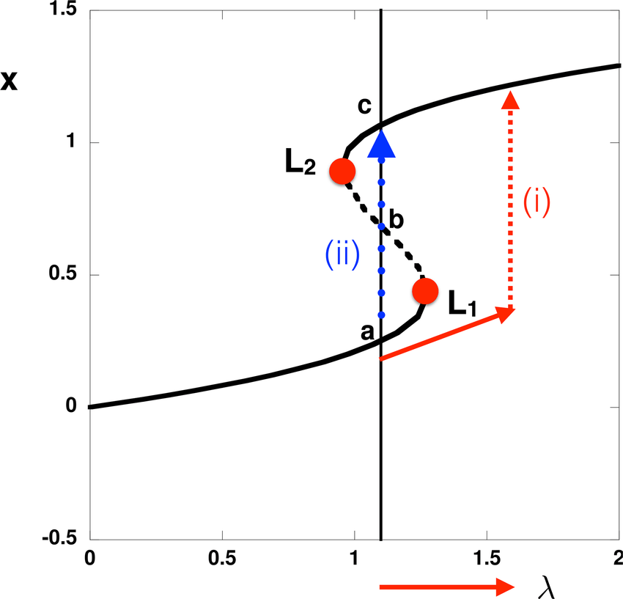
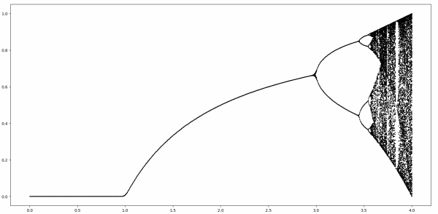
Examples of smooth bifurcations:
Saddle node and tipping points
Transcritical and Pitchfork (super and sub critical)
Period-doubling (and period doubling cascade to chaos)
Hopf (super and sub critical)
Cyclic fold
Homoclinic/heteroclinic

Slide 8
NNs as Dynamical Systems
All feed forward NNs and RNNs can be thought of as maps:
Eg.
Defines a parametrized map
NN: Input x_0 output x_N .
Deep if N >>1. Then we can study the output of the NN as the omega limit set of the map. Training then relates to how the omega limit set depends on the parameters eg. bifurcations etc.

Slide 9
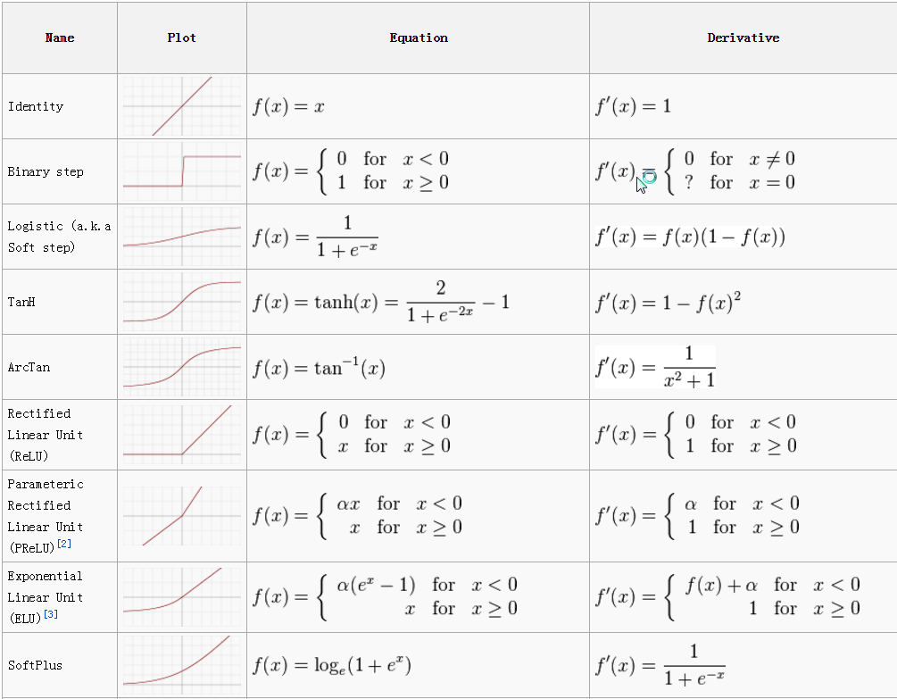
Non-smooth behaviour is introduced through the activation function
Discontinuous
Smoothed discontinuous
Discontinuous derivative
Discontinuous derivative

Slide 10
Lack of smoothness can lead to very rich dynamics
Partly explains the great expressivity of a deep neural network

Slide 11
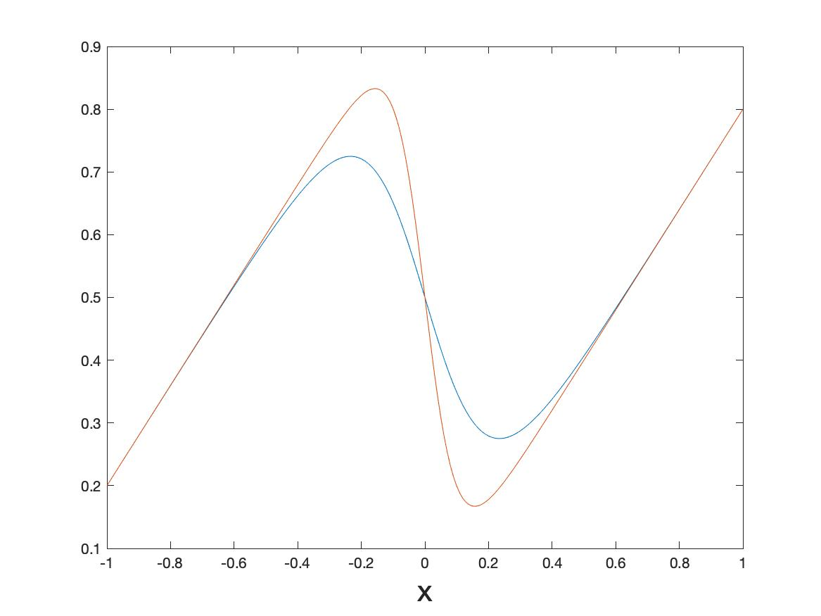
Case Study : Feed forward NN: One-d smoothed sigmoid map
Smoothed to:
c = 10
c = 5

Slide 12
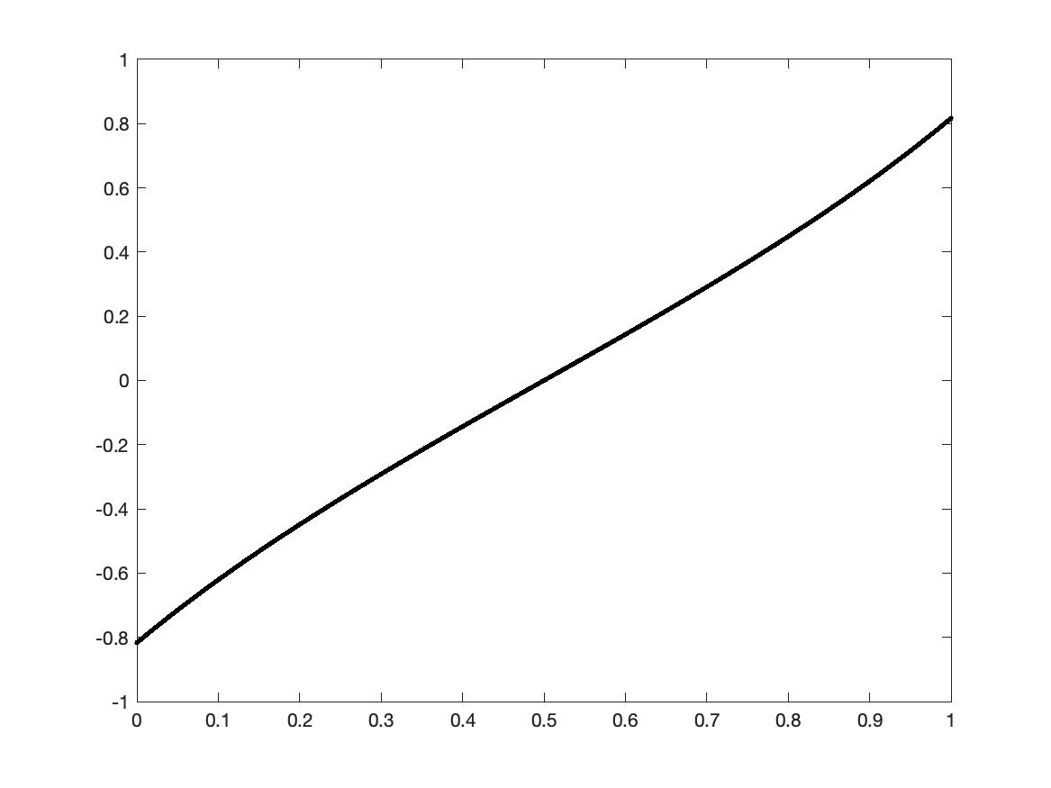
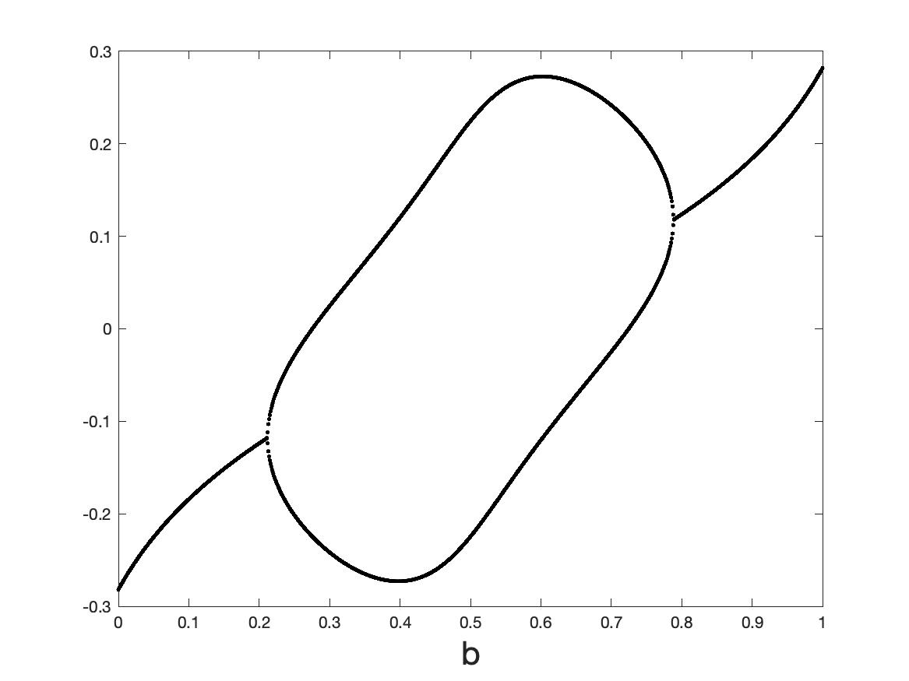
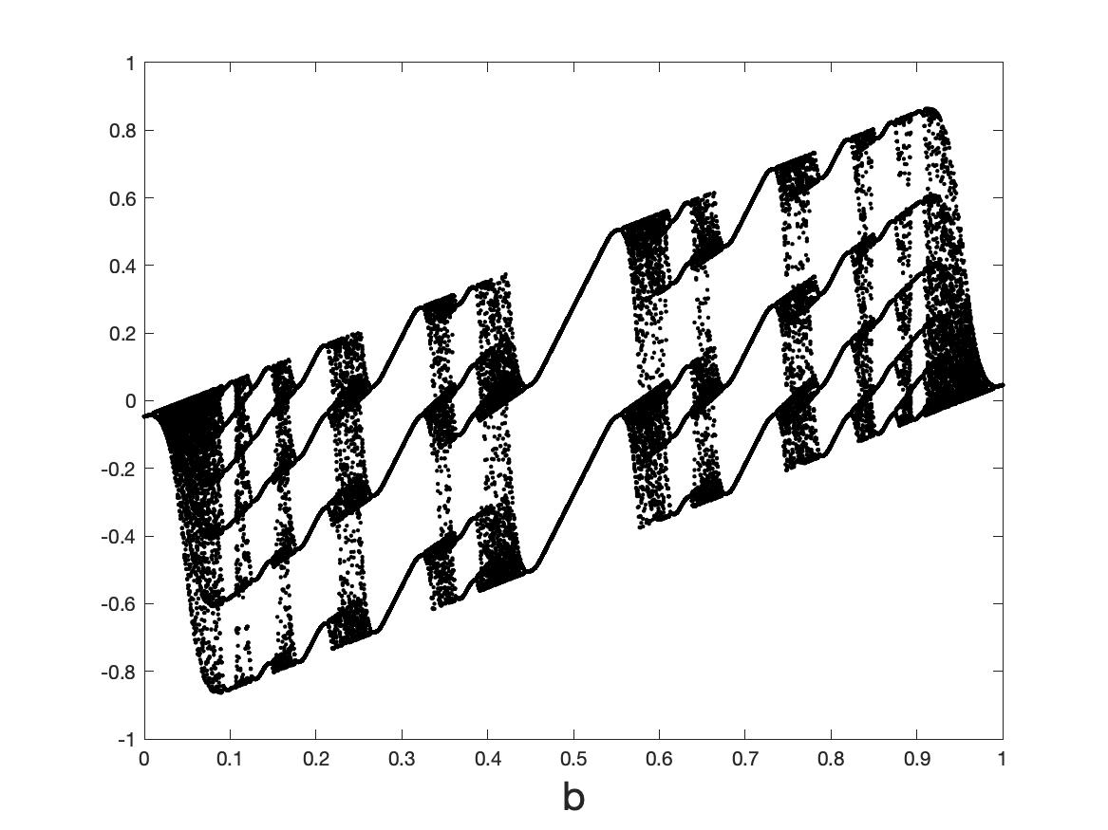
Omega-limit sets as a function of smoothing (when a = 0.8)
c = 1
c = 5
c = 10
c = 50
c = 1000
Border collision

Slide 13
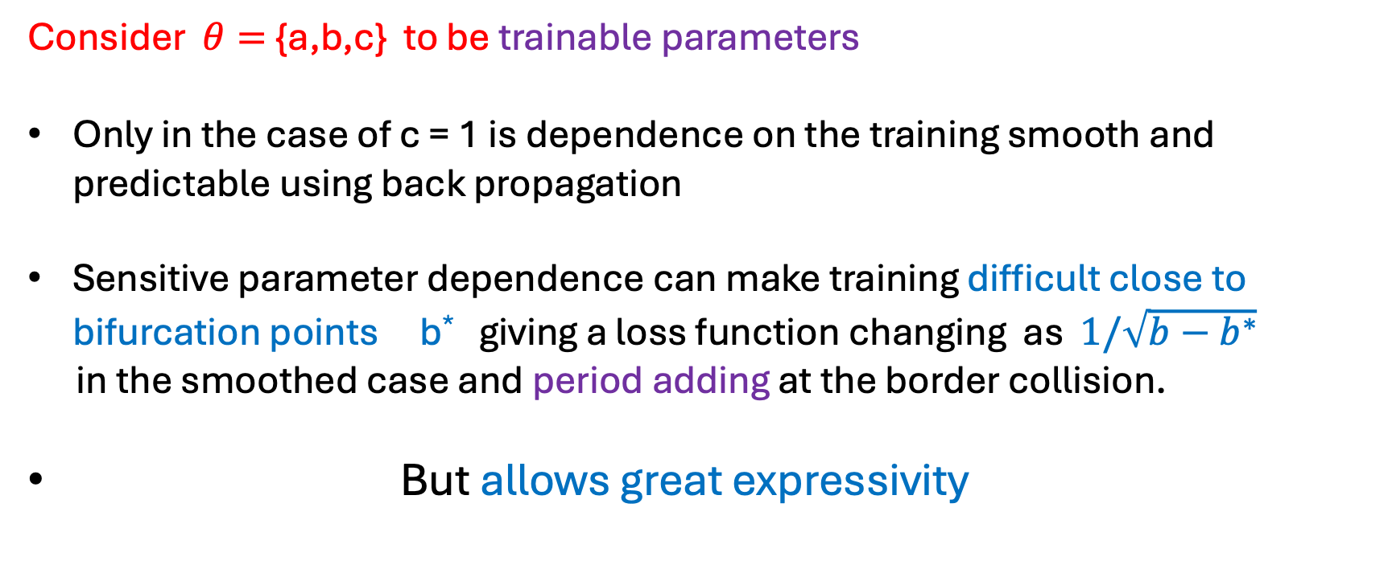
Conclusions from the results
High gradient of the tanh function leads to chaotic behaviour in certain cases. Hard to define a loss function and dependence of the loss function on the input/parameters in this case
Consider $θ=${a,b,c} to be trainable parameters
Only in the case of c = 1 is dependence on the training smooth and predictable using back propagation
Sensitive parameter dependence can make training difficult close to bifurcation points b* giving a loss function changing as $1/\sqrt{b−b^{∗}}$
in the smoothed case and period adding at the border collision.
But allows great expressivity

Slide 14


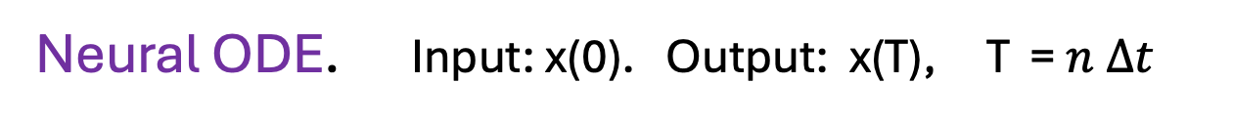
Neural ODES [Chen et. al] : The ResNET architecture as a flow
Let t = $n Δt$
Let $∆t →0$
Neural ODE. Input: x(0). Output: x(T), T = $n Δt$

Slide 15
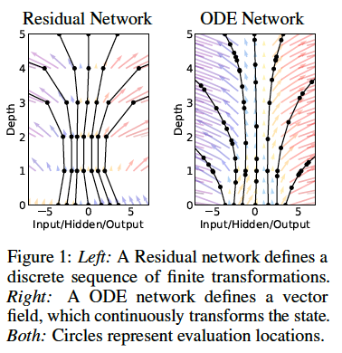
Idea [Chen et. al.]:
Replace the NN by solving the Neural ODE using an ODE solver eg. RK4
Training now becomes a question of finding the functions A(t), b(t), c(t)
Advantages in memory efficiency and back propagation
This a problem in optimal control theory

Slide 16
Training such a ‘Neural ODE’

Slide 17
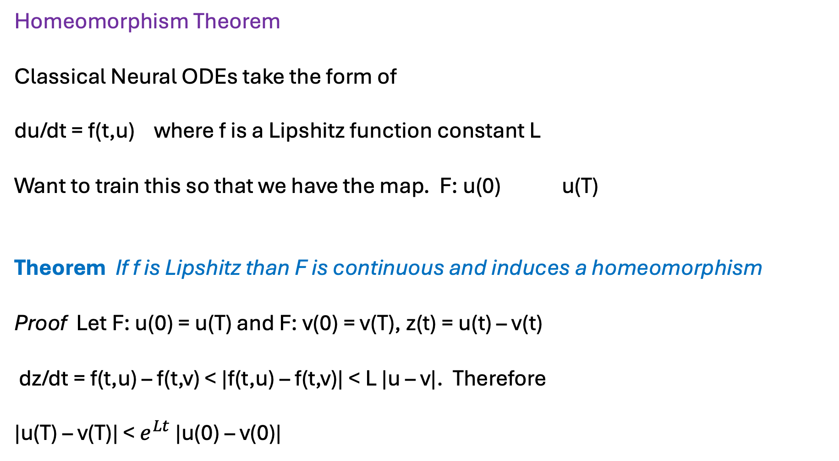
Homeomorphism Theorem
Classical Neural ODEs take the form of
du/dt = f(t,u) where f is a Lipshitz function constant L
Want to train this so that we have the map. F: u(0) u(T)
Theorem If f is Lipshitz than F is continuous and induces a homeomorphism
Proof Let F: u(0) = u(T) and F: v(0) = v(T), z(t) = u(t) – v(t)
dz/dt = f(t,u) – f(t,v) < |f(t,u) – f(t,v)| < L |u – v|. Therefore
|u(T) – v(T)| < $e^{Lt}$ |u(0) – v(0)|

Slide 18


Example: Want to train a Neural ODE to separate data
eg. dogs and cats
Can resolve this topology with a Neural ODE

Slide 19
But this data topology cannot be resolved into two points using a smooth Neural ODE
Have to either use a MAP or a non-Lipshitz Neural ODE

Slide 20
This data topology CAN be resolved using a non-smooth Neural ODE

Slide 21
Discontinuous flow breaks the topology and allows data separation
Question: How do we train these systems?

Slide 22
Dynamical systems defined by Neural Nets and learning dynamics
Can simulate dynamics using a NN
Eg. Original DS is:
Train a NN to approximate this dynamics via:
Data points
Also (and confusingly) called a Neural ODE eg. by Matlab

Slide 23
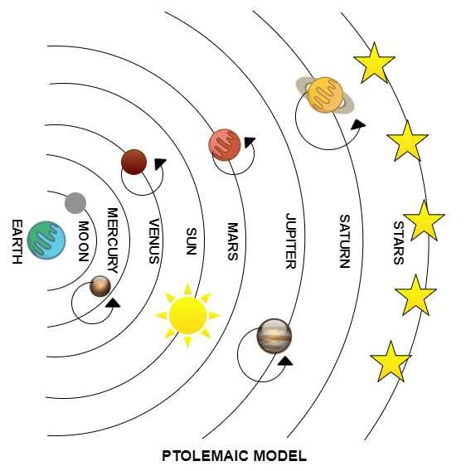
Big literature on these systems
Ptolemaic model of the solar system
Standard learning
Echo State Networks, Reservoir networks
Especially good for chaotic dynamics
SiNDY approach (Kutze) using a very careful choice of RHS (can even work from video data)

Slide 24
Training such a ‘Neural ODE’

Slide 25
Possible dynamics of such Neural ODEs
f(.) output of a feed-forward Neural Network
f(.) Can be piecewise smooth, continuous or even discontinuous
Non-smooth nature of the dynamics places a significant constraint on the possible dynamics of the neural ODE, and helps understand what dynamics might be possible

Slide 26
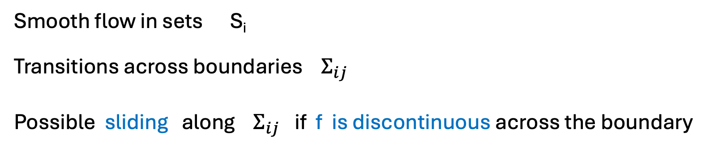
For example, NN naturally lead to:
Filippov Flows
Smooth flow in sets S_{i}
Transitions across boundaries $Σ_{ij}$
Possible sliding along $Σ_{ij}$ if f is discontinuous across the boundary

Slide 27
Filippov dynamical system without sliding
Typical ‘transverse’ intersection

Slide 28
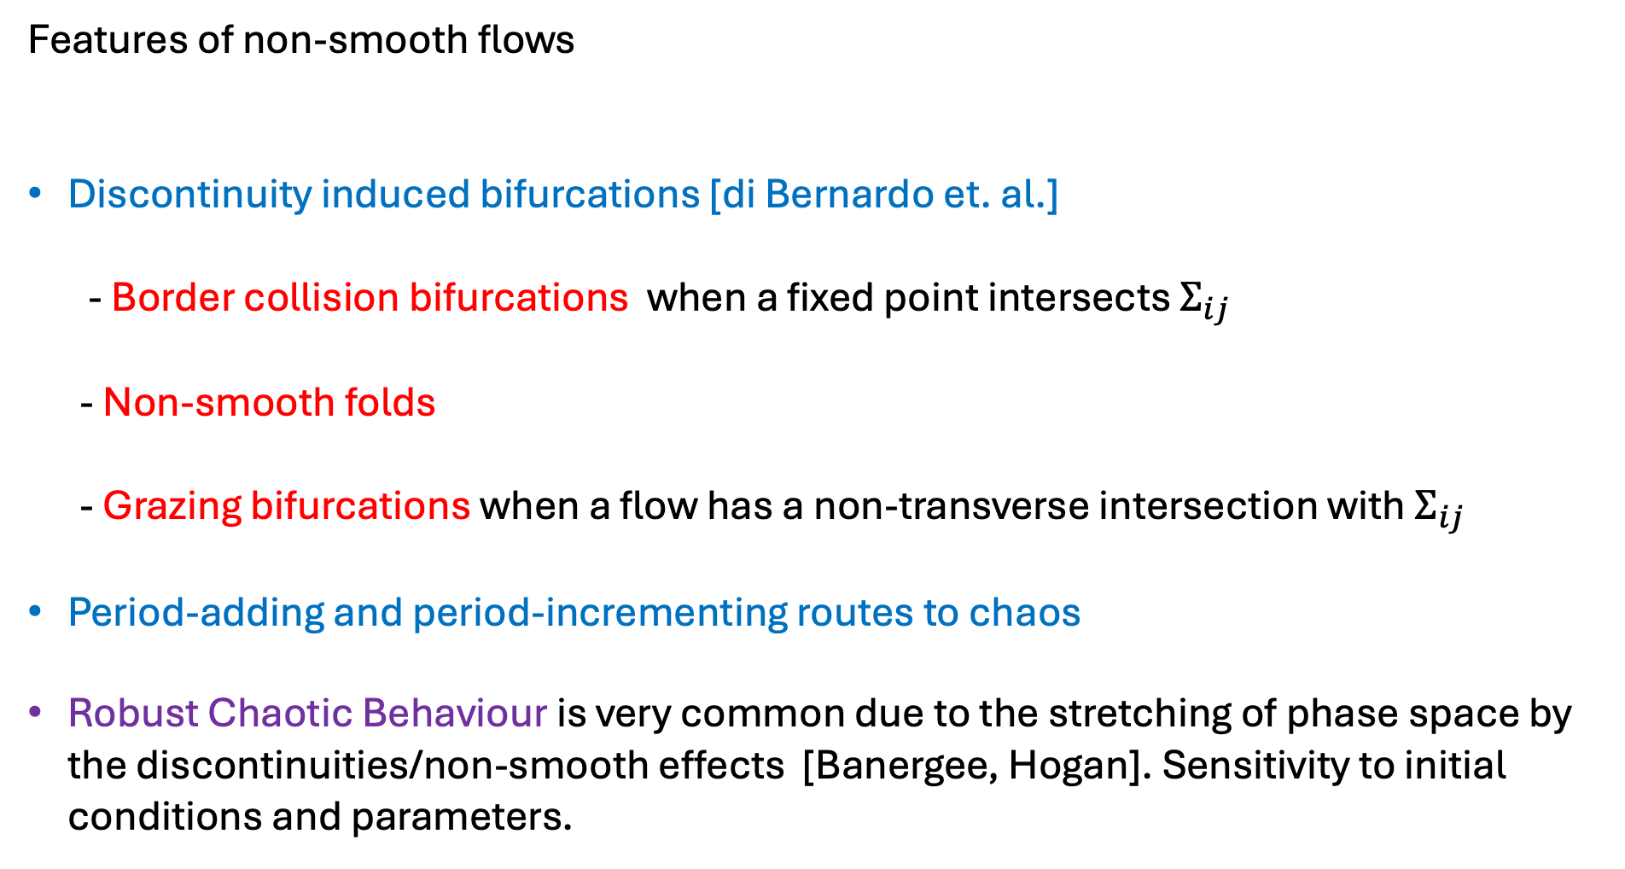
Features of non-smooth flows
Discontinuity induced bifurcations [di Bernardo et. al.]
- Border collision bifurcations when a fixed point intersects $Σ_{ij}$
- Non-smooth folds
- Grazing bifurcations when a flow has a non-transverse intersection with $Σ_{ij}$
Period-adding and period-incrementing routes to chaos
Robust Chaotic Behaviour is very common due to the stretching of phase space by the discontinuities/non-smooth effects [Banergee, Hogan]. Sensitivity to initial conditions and parameters.

Slide 29
Example 1: Border equilibrium bifurcation in a climate related NODE with a (smoothed) Heaviside activation function
Smoothed

Slide 30
Unforced system (Heaviside)
Two Fixed points
Physical
Virtual

Slide 31
Theorem
There exist critical values of the parameter d
If fixed point is physical and globally attracting
If fixed point is physical and globally attracting
If see a periodic solution
Transitions occur at Border Collision Bifurcations when

Slide 32
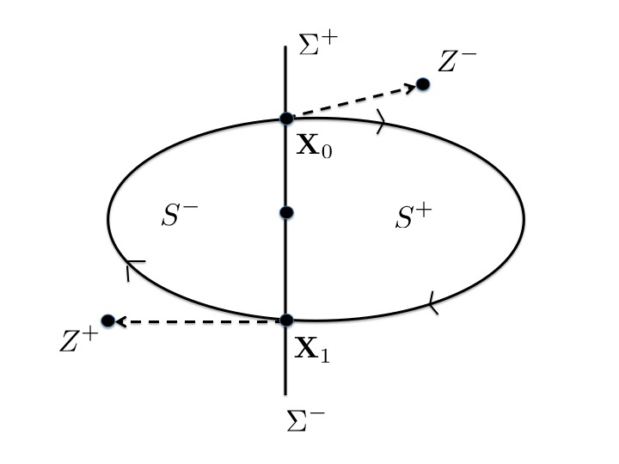
Existence of a periodic orbit
Virtual
F(X) > 0
F(X) < 0
Virtual
: F(X) = 0
Proof using the Brouwer Fixed Point. theorem

Slide 33
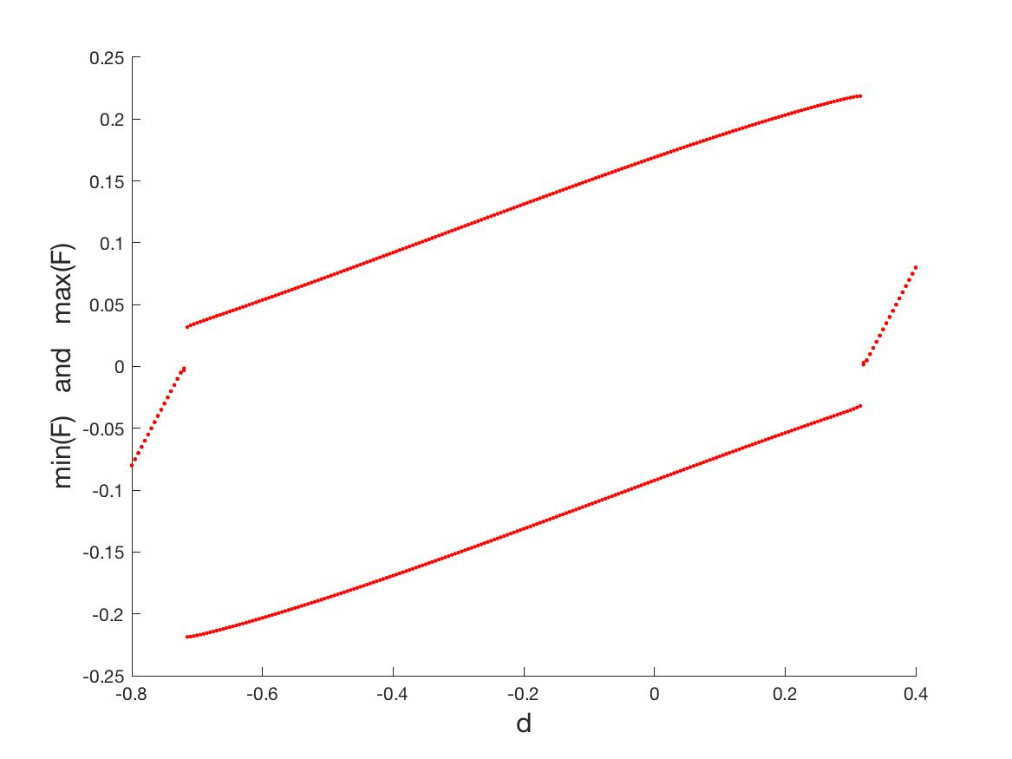

Bifurcation diagram: Heavyside
Periodic
Fixed point
Border collision bifurcation
Fixed point
$$η=10000$$

Slide 34
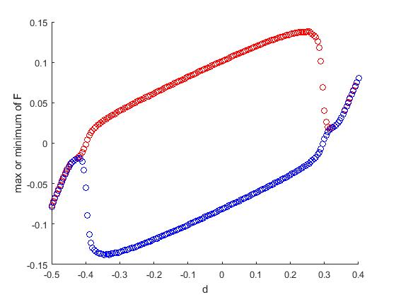

Bifurcation diagram: (smoothed) tanh
Periodic
Fixed point
Sub-critical Hopf bifurcation
Fixed point
$$η=100$$

Slide 35
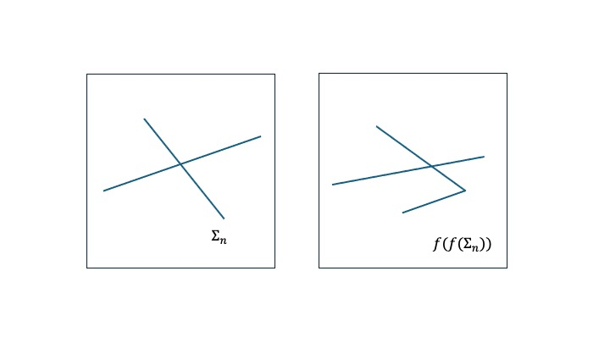
Example 2: Fixed point, Limit Cycle, and Chaotic Dynamics in ReLU type ODEs
(+,+)
(+,0)
(0,+)
(0,0)

Slide 36
Evolution of a fixed point. (2-dimensions)
Back propagation OK
FP
Back propagation fails

Slide 37
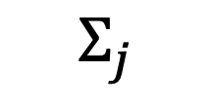
Local behaviour (n – dimensions) when back propagation fails
c^{T} x = d
$$Σ_{j}$$

Slide 38

General case: Normal form at the transition
All ReLU type dynamics can be expressed locally close to the switch manifold as:
Possible scenarios:
FP → FP
FP + FP → $∅$
FP → Limit cycle
FP → Chaos
Can classify many of the transitions in terms of the structure of A_{i} and b.
[Freire], [Carmona]

Slide 39
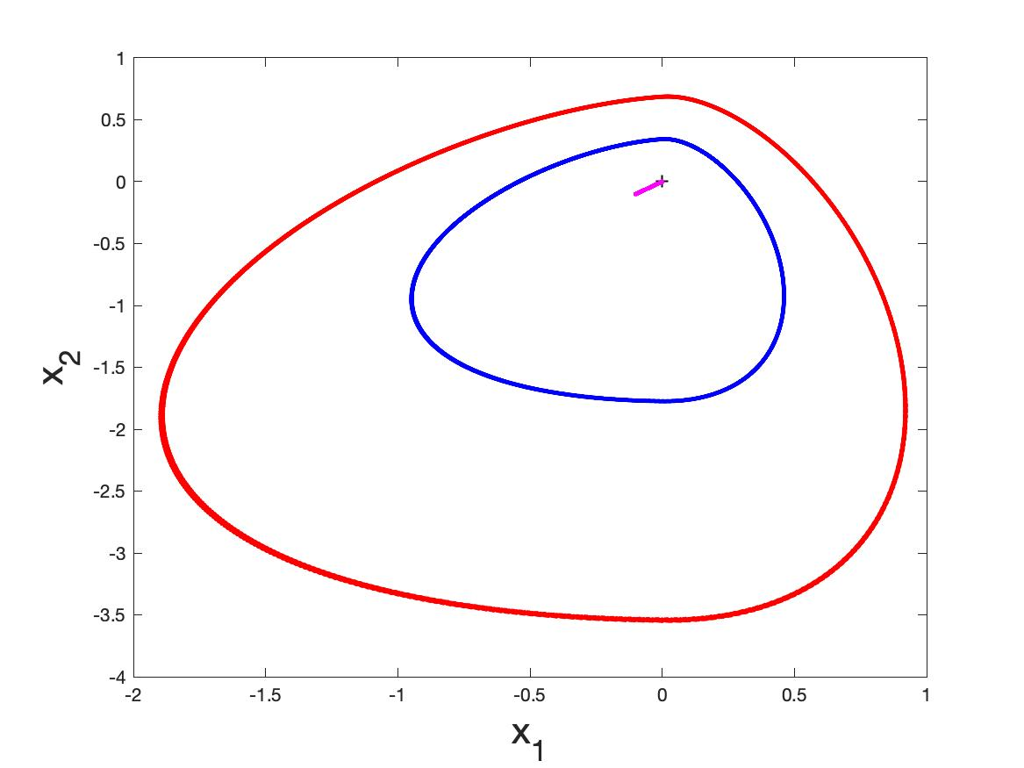
Example: FP → Limit Cycle

Slide 40
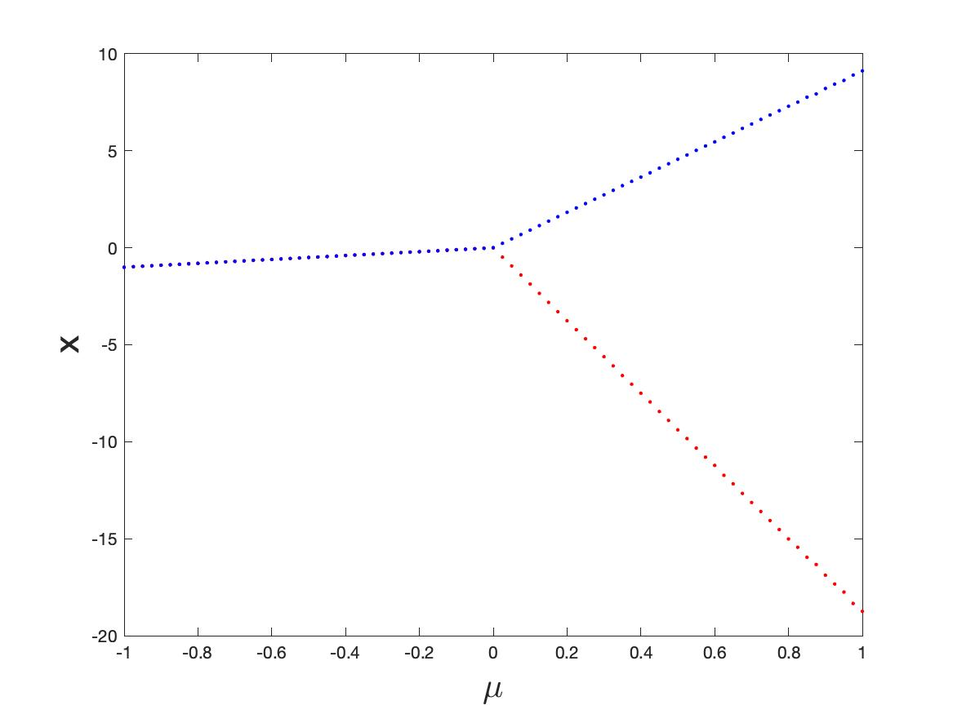
Max(x)
Fixed point
Min(x)
Limit cycle

Slide 41
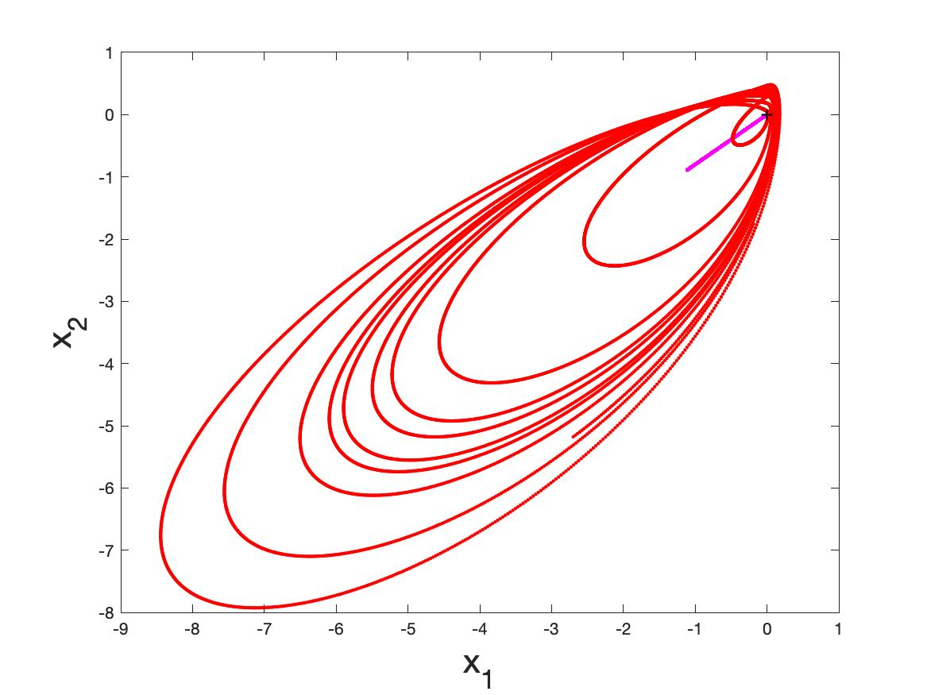
Example 2: FP → Chaos

Slide 42
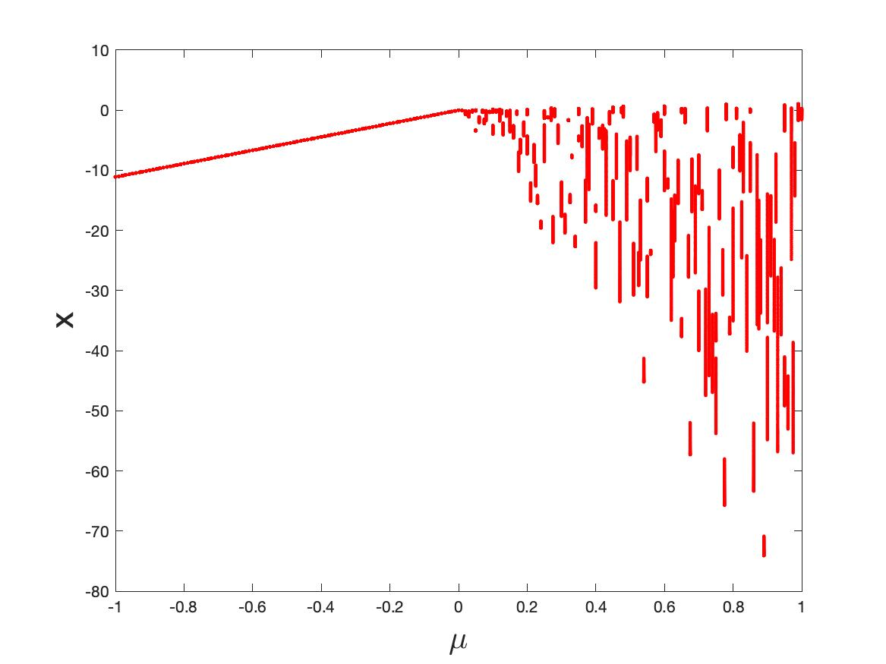
Fixed point
Chaos

Slide 43
Davide material here

Slide 44
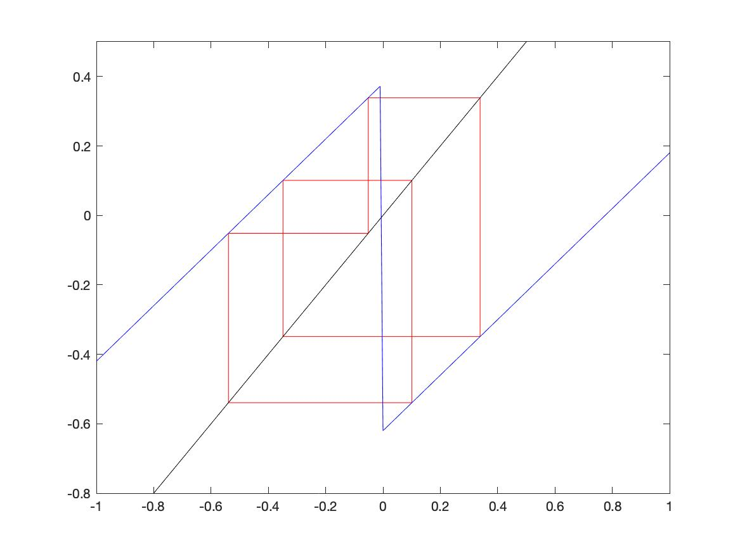
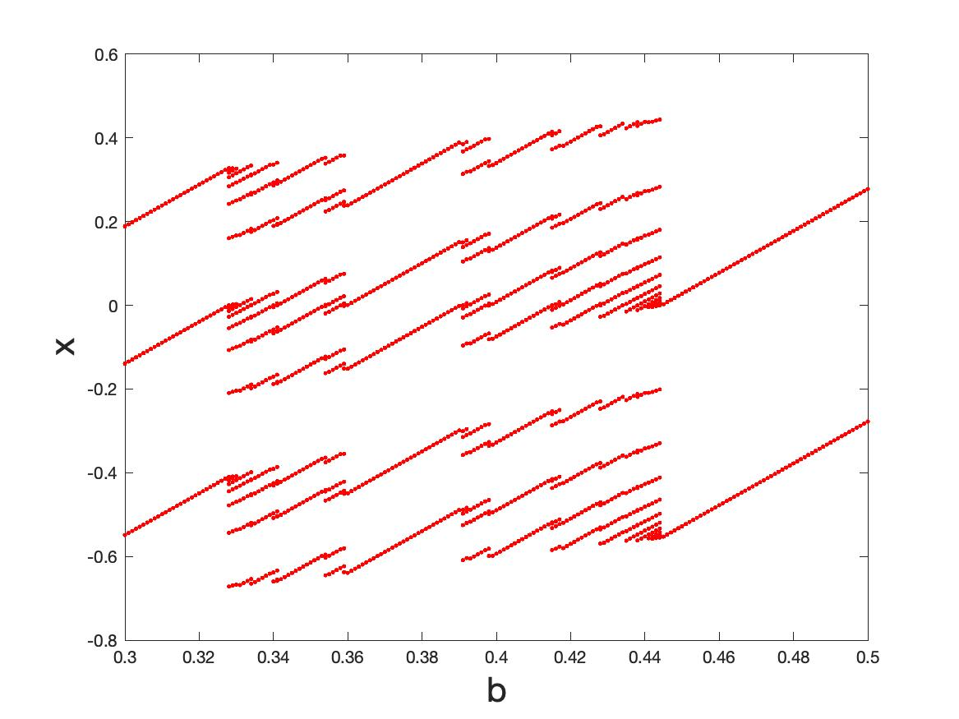
Eg. Periodic behaviour in an iterated map with a gap (almost a circle map)
Close to discontinuity
7
3
8
5
2
Border collision
Period 5 at b = 0.38
Period adding

Slide 45
Full Period-adding behaviour
8
5
8
3
7
5
7
2
8
5
3

Slide 46
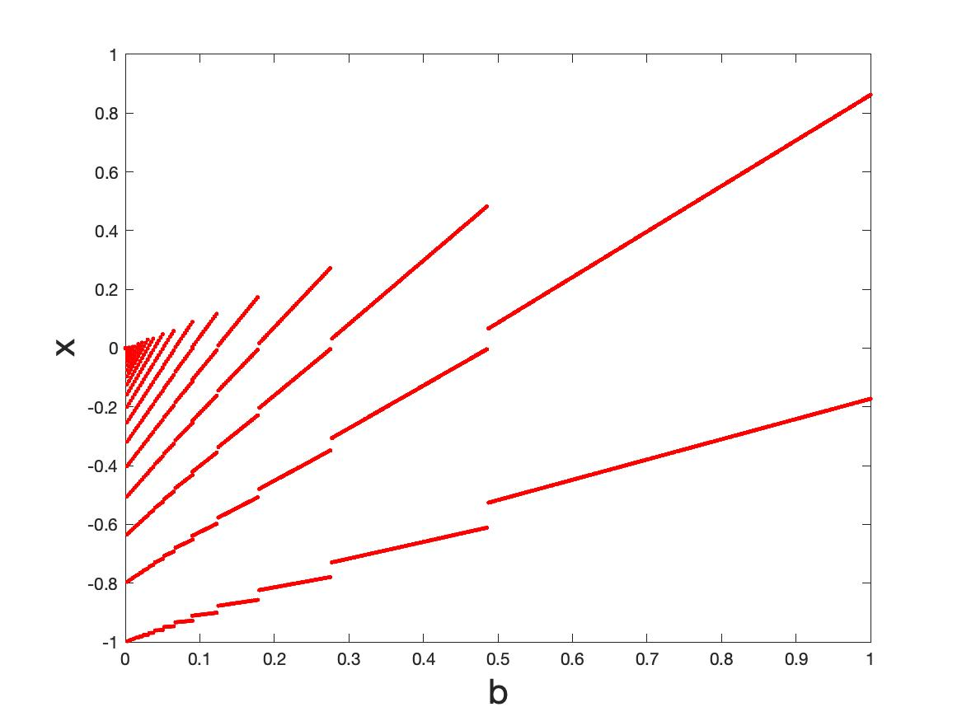
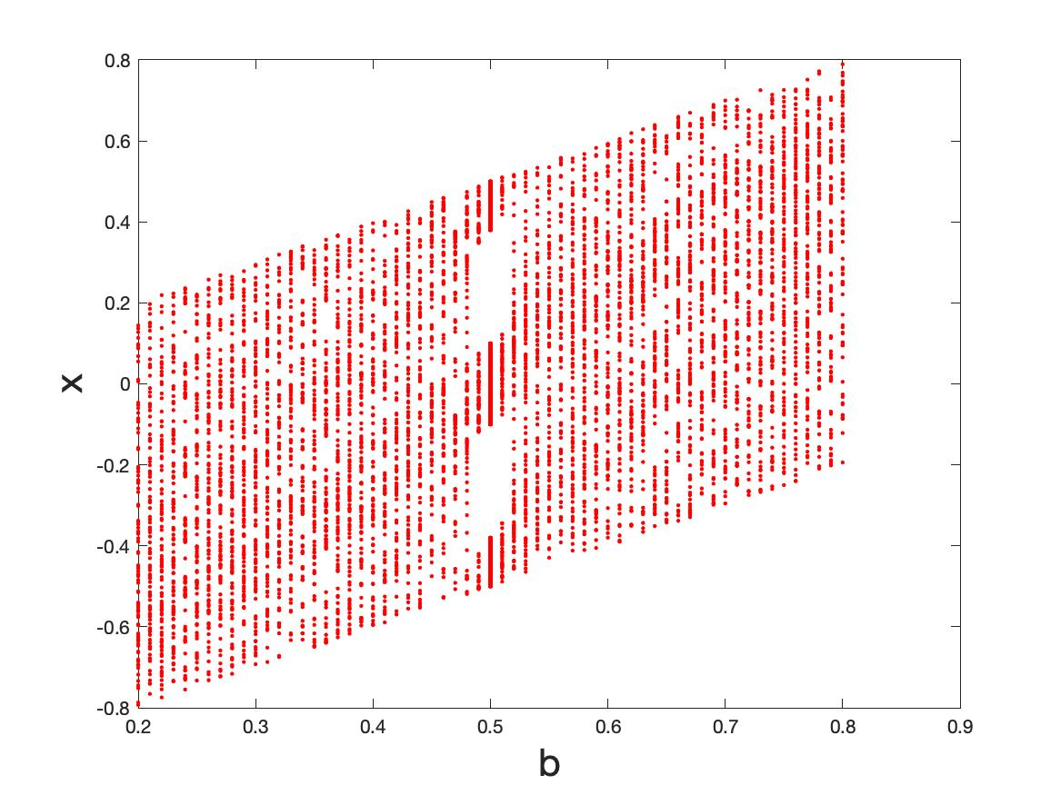
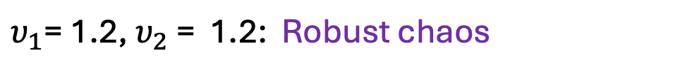
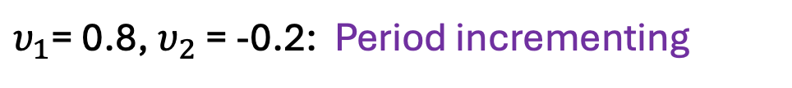
$υ_{1}$= 0.8,$υ_{2}$ = -0.2: Period incrementing
$υ_{1}$= 1.2,$υ_{2}$ = 1.2: Robust chaos

Slide 47
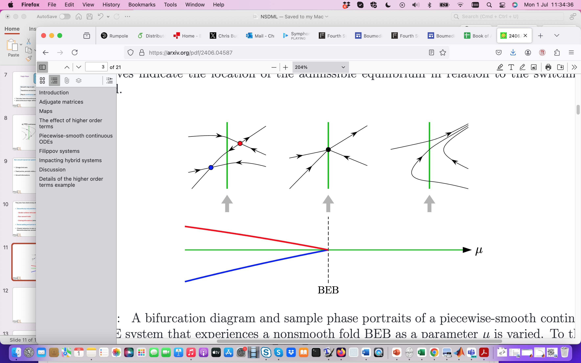
Flows: Non-smooth fold (boundary equilibrium bifurcation)

Slide 48
Applications of non-smooth dynamics
Mechanical systems with impact and friction
Electronic systems with switching
Neuro-science
Biological system eg. Sleep models
Climate models eg. ice-ages, AMOC
Any system with very disparate time/length scales
Machine learning
Rapid tipping at a non-smooth fold

Slide 49
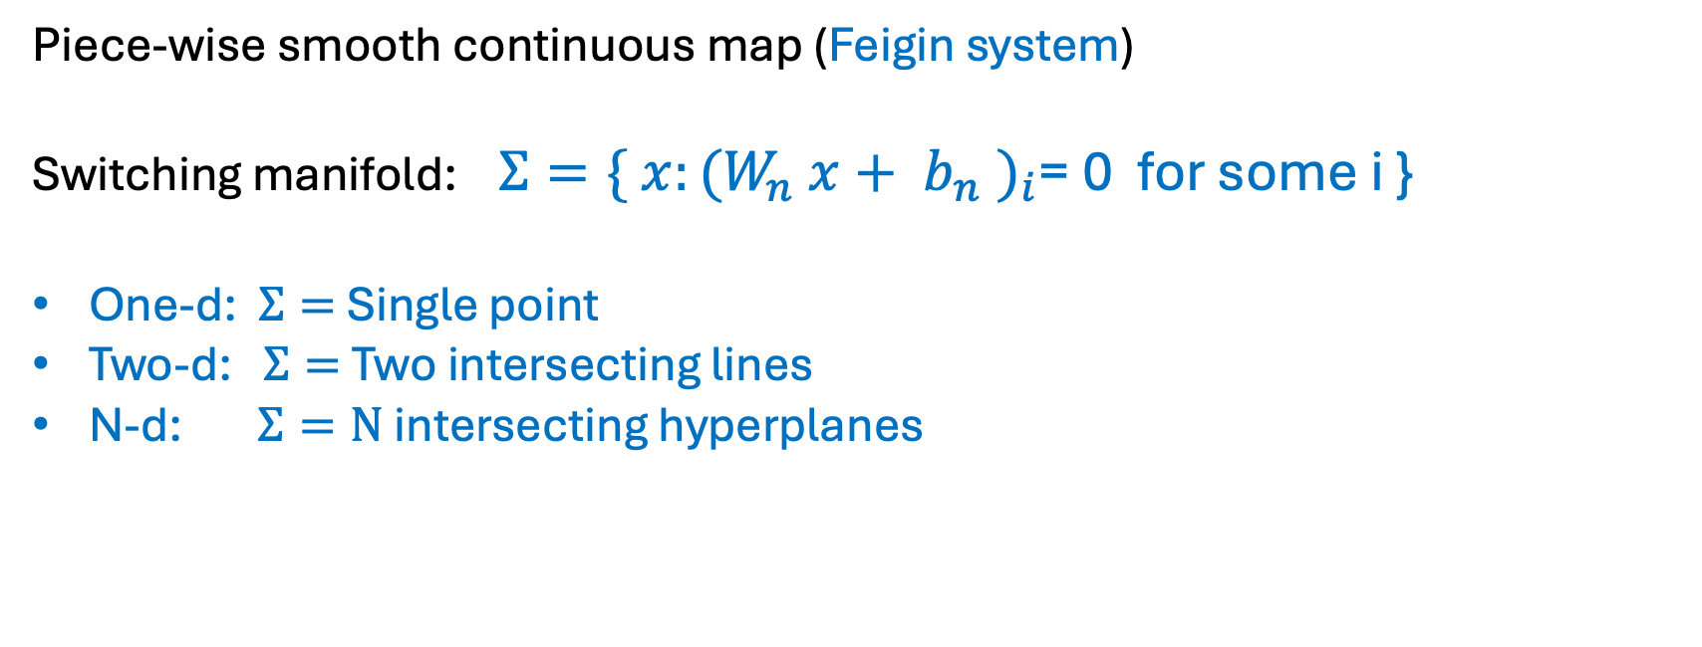
ReLU as a special case:
Piece-wise smooth continuous map (Feigin system)
Switching manifold: $Σ=\{ x:(W_{n} x+ b_{n} )_{i}$= 0 for some i }
One-d: $Σ=$Single point
Two-d: $Σ=$Two intersecting lines
N-d: $Σ=N$ intersecting hyperplanes

Slide 50
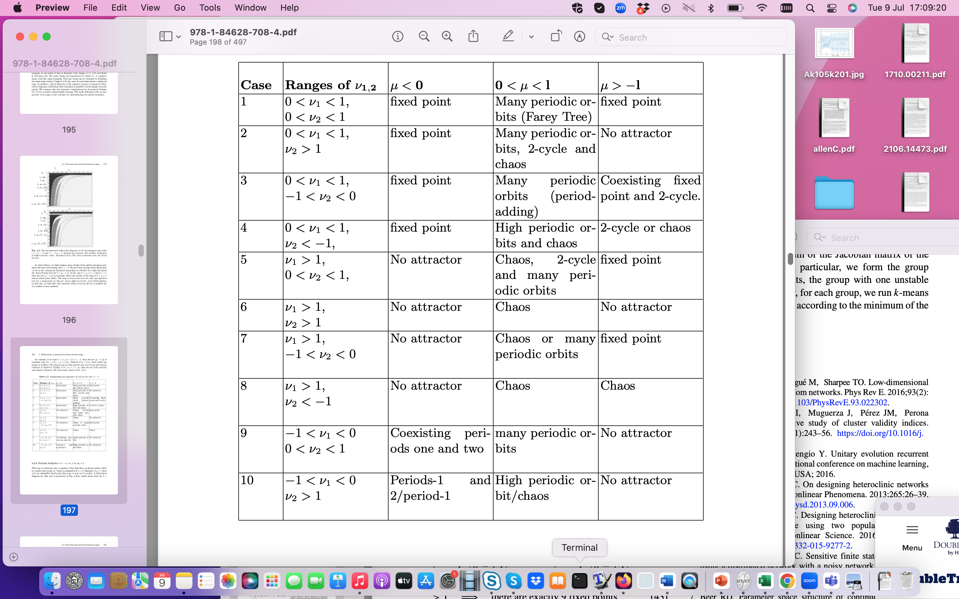
Classification [B et. al]: Suppose we have a sigmoid type NN of the form
Guide to what we might expect as we pass through a training process

Slide 51
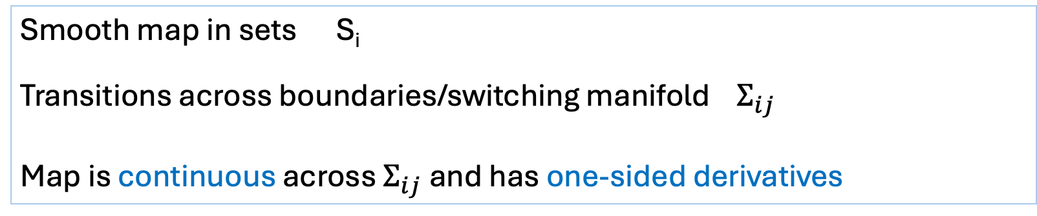
Eg Feigin Maps
Smooth map in sets S_{i}
Transitions across boundaries/switching manifold $Σ_{ij}$
Map is continuous across $Σ_{ij}$and has one-sided derivatives
Can also have discontinuous maps (maps with a gap)
and continuous maps without one-sided derivatives (eg. square-root maps)

Slide 52
Non-smooth dynamical systems share many features with smooth ones
Omega-limit sets
Fixed points, periodic orbits, chaos
Smooth bifurcations

Slide 53
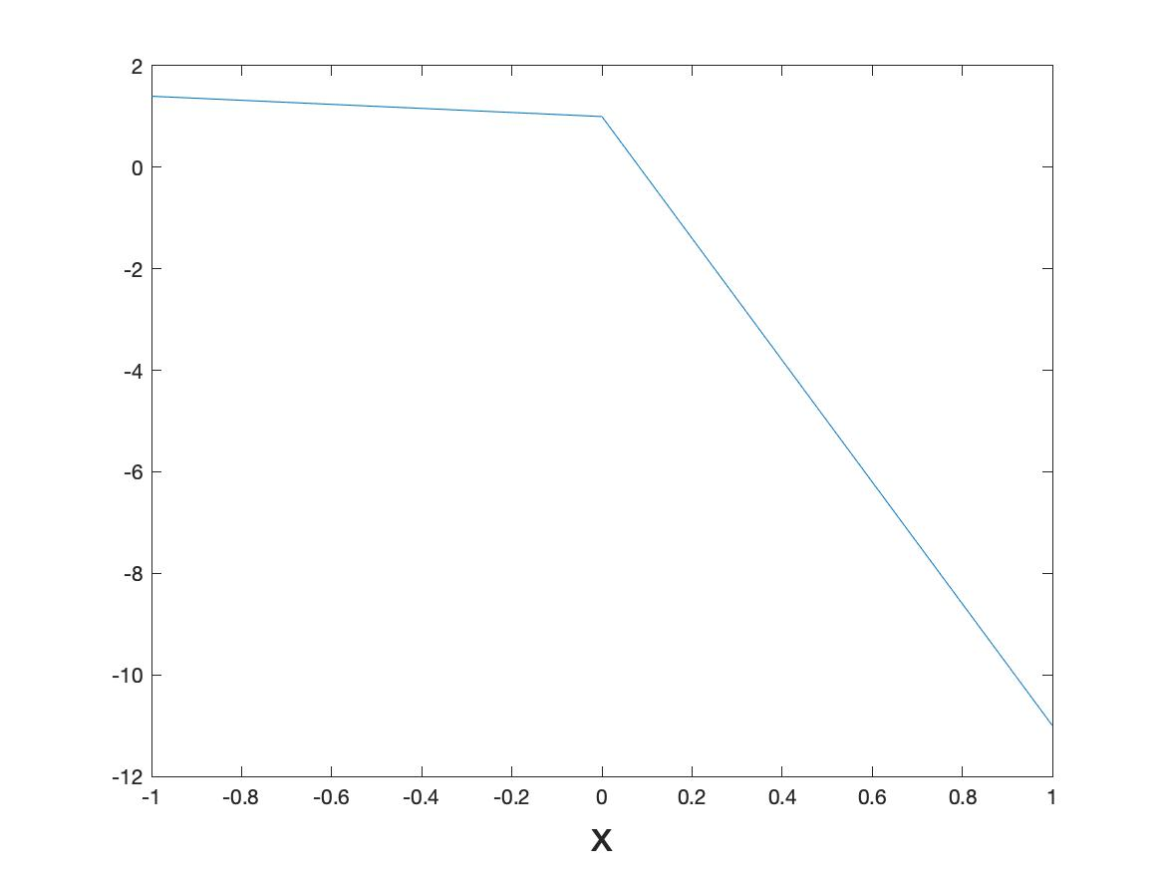
Case Study Two: One-d and two ReLu functions combined

Slide 54
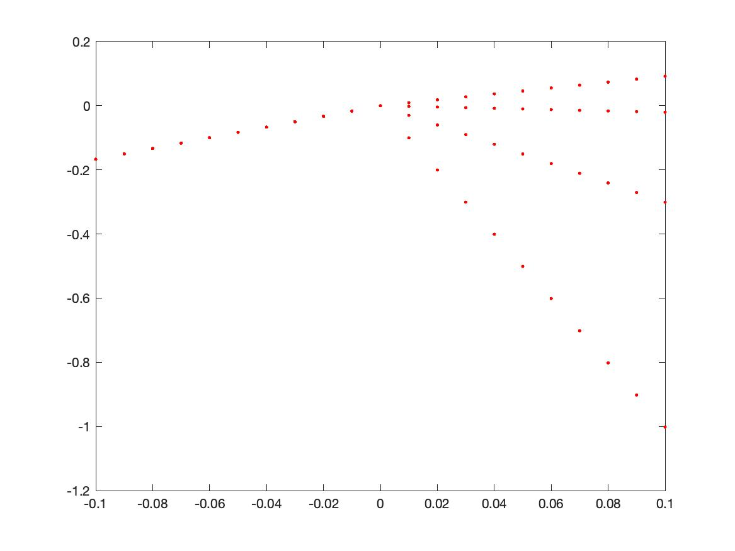
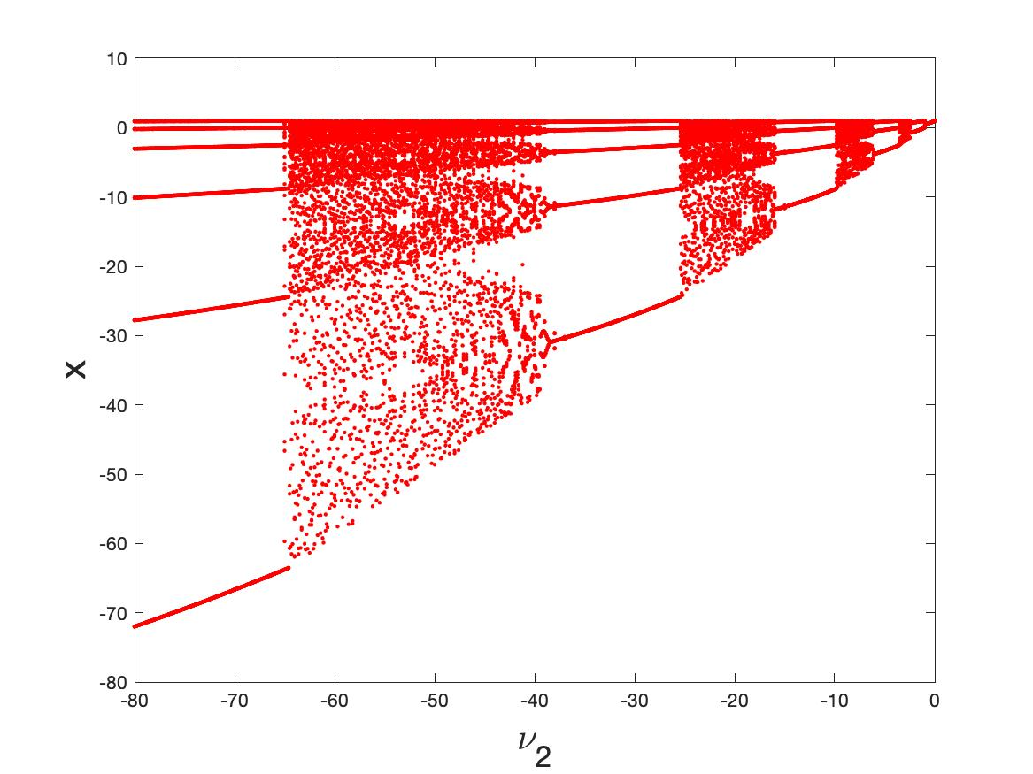
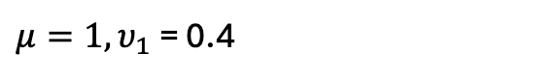
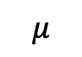

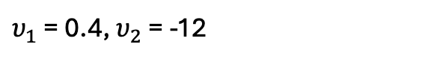
Omega-limit sets. $υ_{1}$ = 0.4
[Helena E. Nusse, ' Edward Ott, and James A. Yorke’,94]
$$μ$$
$υ_{1}$ = 0.4, $υ_{2}$ = -12
$μ=1, υ_{1}$ = 0.4

Slide 55
Comments (similar) on the ReLU dynamics
Dynamics is determined by the symbolic sequences of points lying L or R of x = 0
Observe both periodic cycles and robust chaotic behaviour
Bifurcations arise when a symbol crosses x = 0 at a border collision. This cannot be determined from a back propagation type of analysis
Get good expressivity. Need to consider how symbol sequences work for this
Can extend this naturally to higher dimensions but symbol sequences are much harder
Note that chaotic behavior is seen in ESNs as well [Ashwin et. al. ]

Slide 56
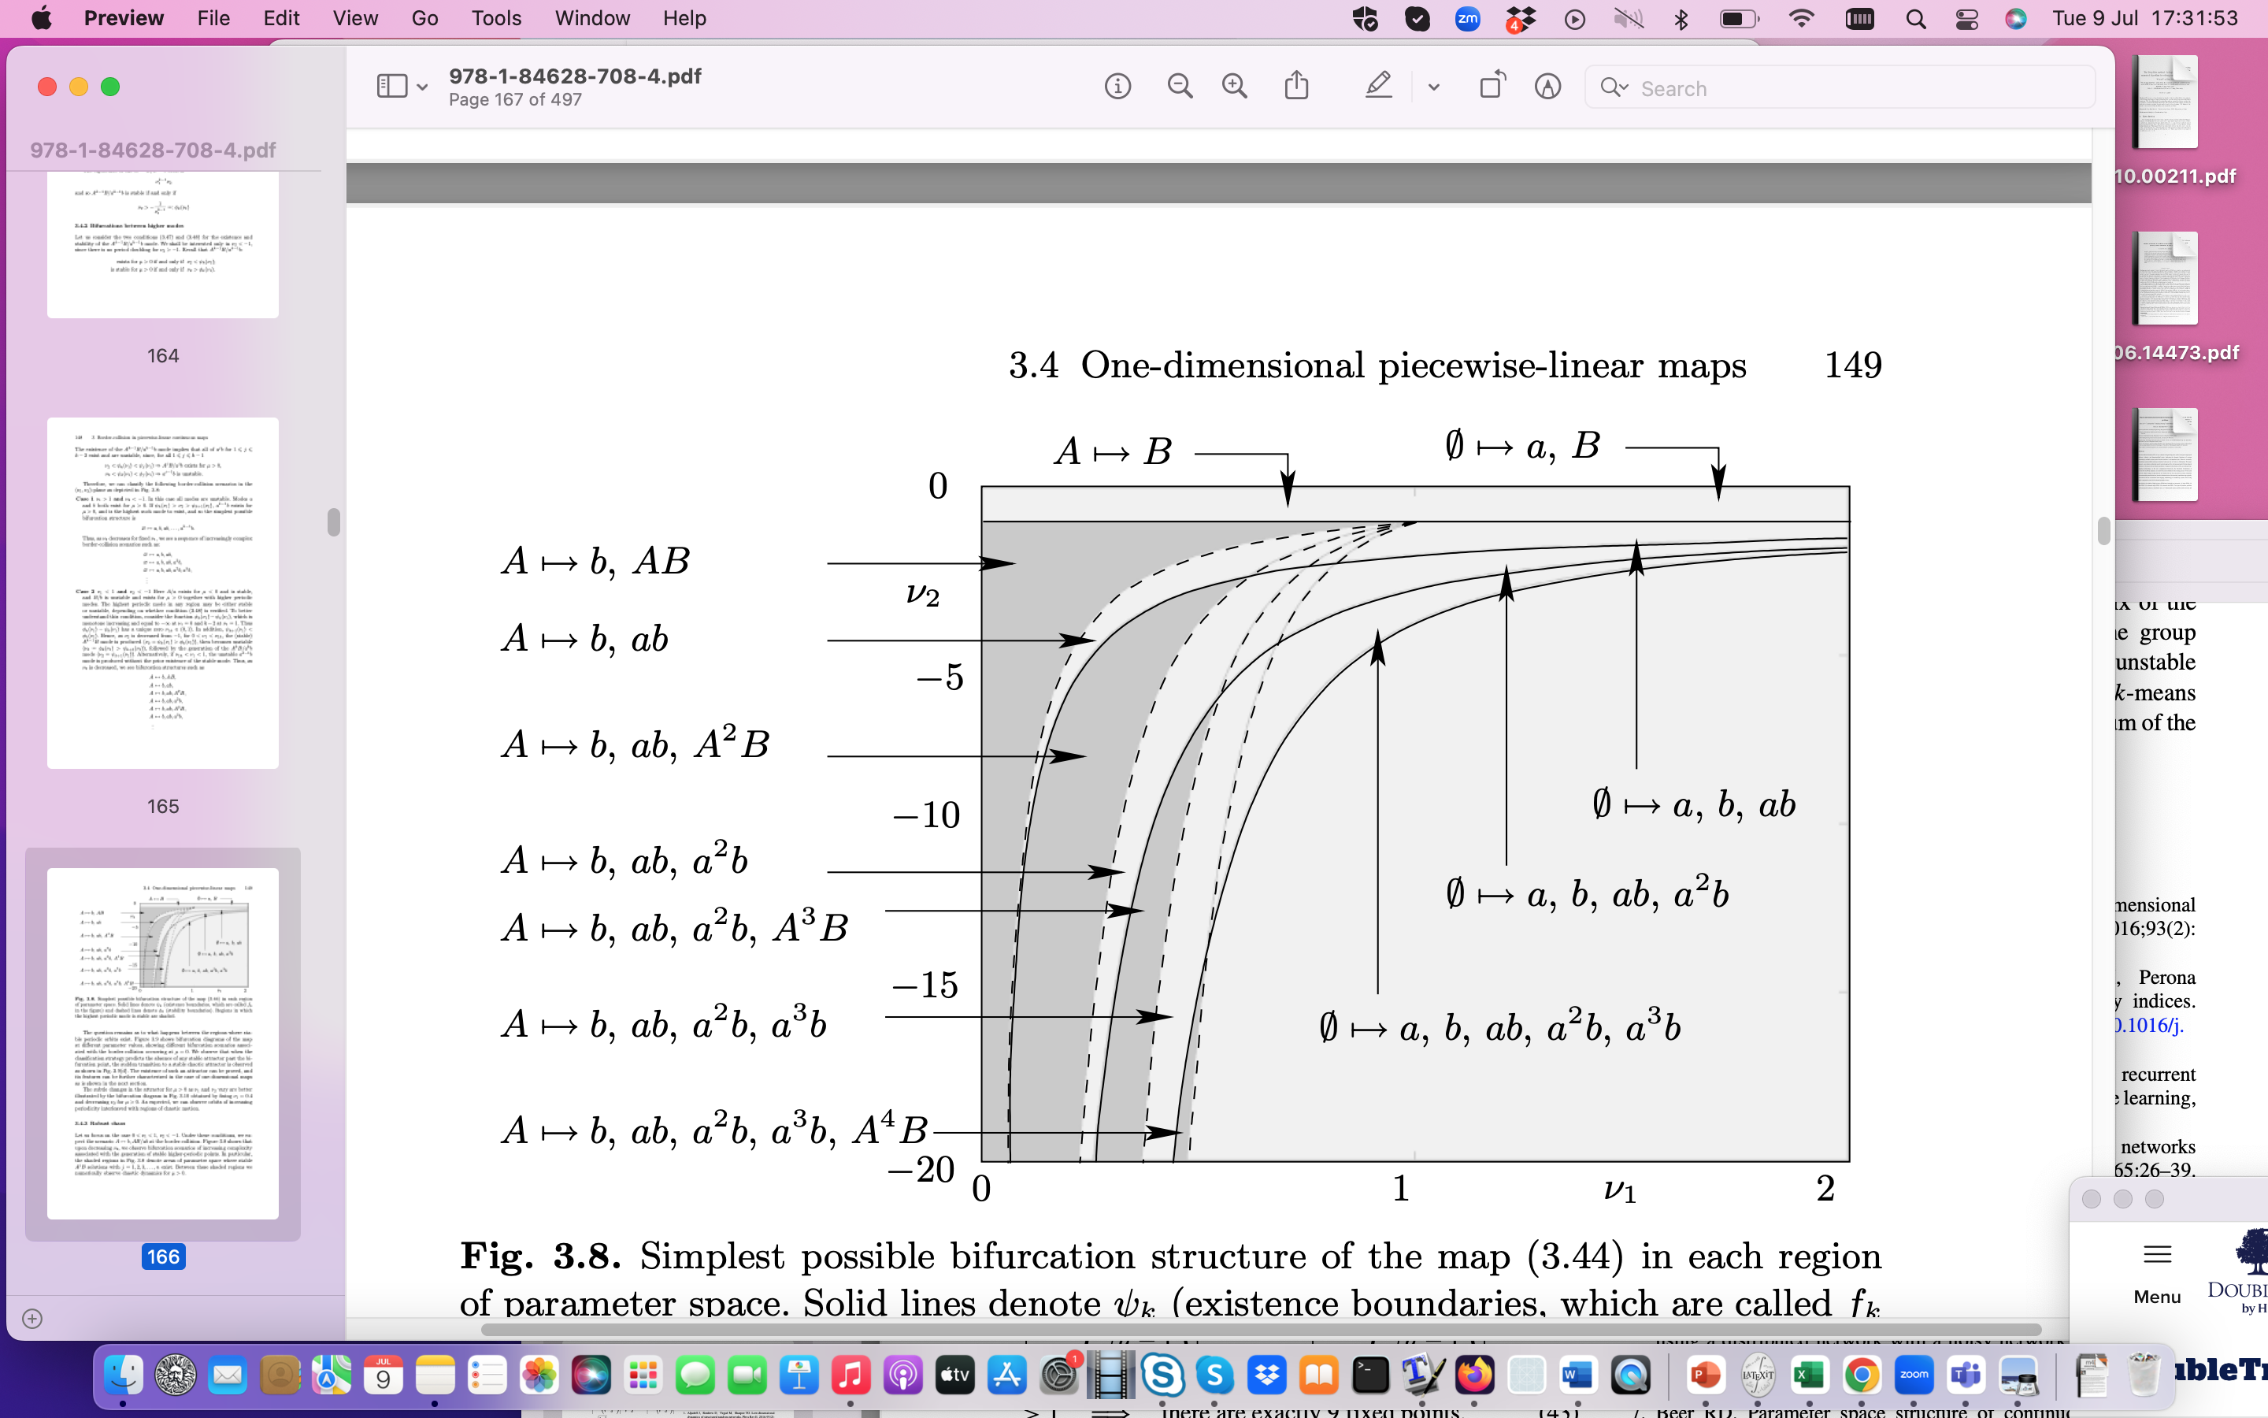
Classification: Suppose we have ReLU type NN of the form
A/a : Left of switch
B/b : Right of switch

Slide 57
Conclusions and Next Steps
Have demonstrated that typical activation functions can lead to complex (FP, Periodic, chaotic) in feed forward NN and neural ODEs
Can classify certain complex behaviour at transition points where back propagation breaks down
Need to test on realistic ML architectures with multiple switching surfaces
Need to understand how identifying NSD structures might improve training and control as discontinuity manifolds are crossed

Slide 58
References
H. Nusse, E. Ott, and J. Yorke. Border collision bifurcations: an explanation for observed bifurcation phenomena. Phys. Rev. E, 49:1073–1076, 1994.
Mario Di Bernardo, B. , et. al. ‘Piecewise smooth dynamical systems: theory and applications’, Springer 2008
Igor Belykh, Rachel Kuske, Maurizio Porfiri, and David J. W. Simpson, ‘Beyond the Bristol book: Advances and perspectives in non-smooth dynamics and Applications, 2023
E. Freire, E. Ponce, F. Rodrigo, and F. Torres. ‘Bifurcation sets of continuous piecewise linear systems with two zones’. International Journal of Bifurcation and Chaos, 8(11):2073–2097, 1998.
V. Carmona, E. Freire, E. Ponce, and F. Torres. Bifurcation of invariant cones in piecewise linear homogeneous systems. International Journal of Bifurcation And Chaos, 15(8):2469–2484, August 2005.
Andrea Ceni, Peter Ashwin, Lorenzo Livi, ‘Interpreting Recurrent Neural Networks Behaviour via Excitable Network Attractors’, Cognitive Computation (2020) 12:330–356

Slide 59
Non-smooth dynamical systems
Flows:
Maps:
The function f(. ) is a non-smooth function of its arguments
(or a slightly regularized version of a non-smooth function)

Slide 60
Part 1: Smooth dynamical systems
Flows:
Maps:
Usual assumption:
The function f(. ) depends smoothly on all of its arguments

Slide 61
Possible applications of NSD in machine learning
Example One: Basic feed forward (ResNet) architecture as a non-smooth map
Input: x₀ Output: x_{L}
Discrete dynamical system.
If deep with L >> 1 then the output is on the omega-limit set

